Slide 1
Intro To Android
Android SDK Setup

Slide 2
Android SDK
IDE = Integrated Development Environment
Everything you need to Write App, Deploy, debug, and publish in One App
Download from http://Developer.android.com

Slide 3
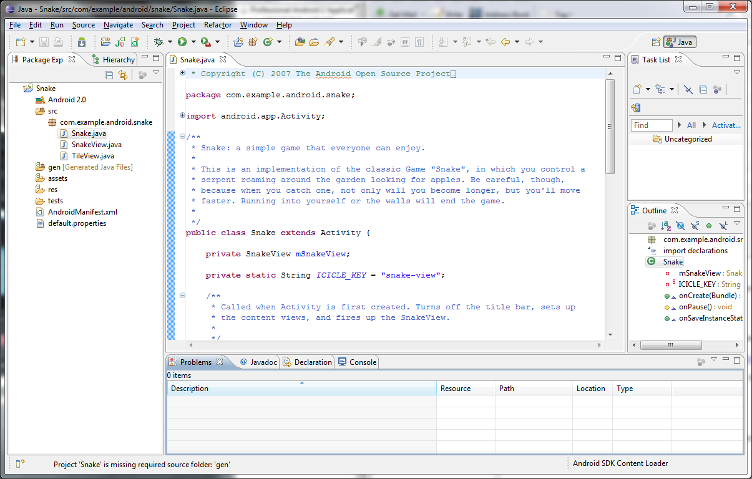

Slide 4
Project File structure
AndroidManifest.xml
App properties and permissions
/src
All java source code
/res
Resources files like images, layout files, strings, other values
/bin & /gen
Generated output files after compile
Assets
Other resources that are not in /res (fonts)

Slide 5
First Android Project

Slide 6
Configure Emulator

Slide 7
Open Sample Project

Slide 8
Start App

